Slide 1








Remote Unmanned Aircraft System (UAS) Inspection and Response Team Development in the Bering Strait Region
A presentation by
Dr. Jessica Garron, University of Alaska, Principal Investigator
ADAC: Research for the Arctic Operator… For Today and For the Future
ADAC: Research for the Arctic Operator… For Today and For the Future

Slide 2

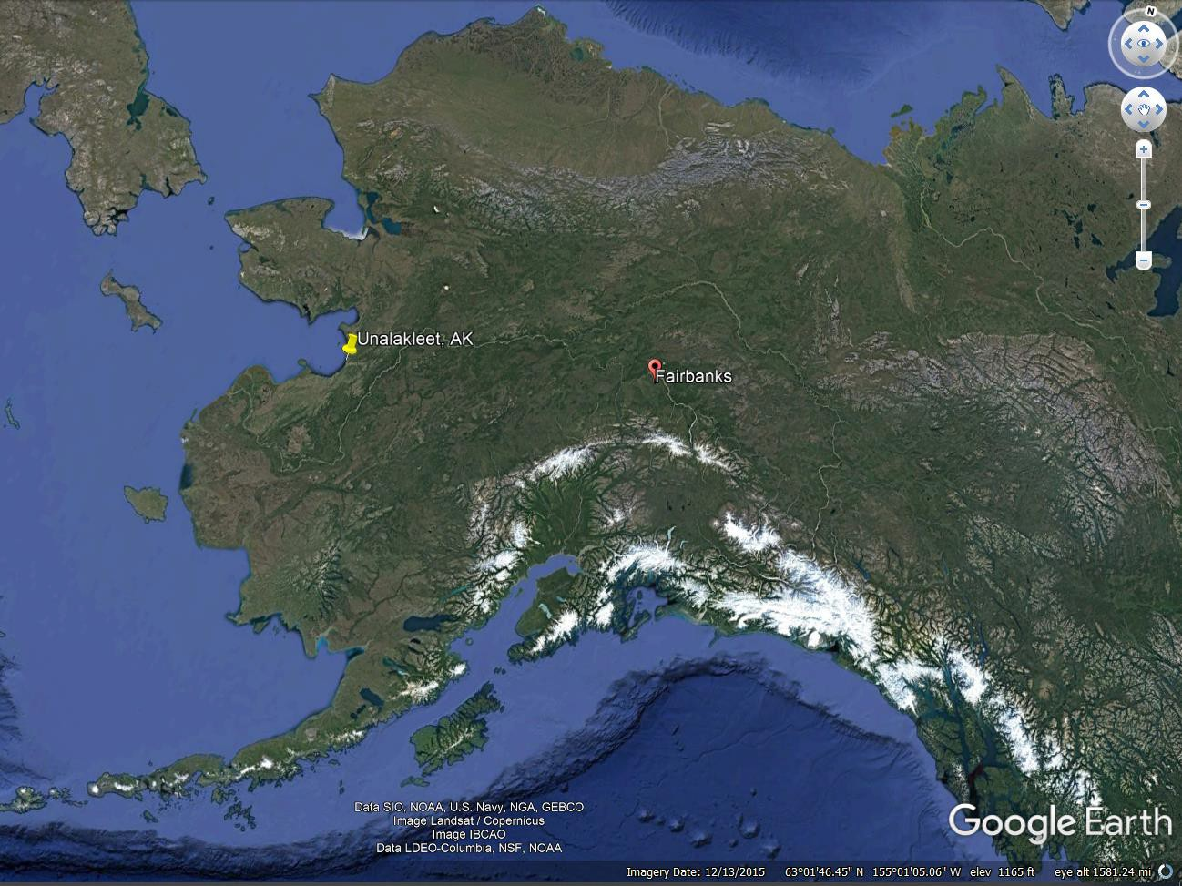
Land Acknowledgement
ADAC Program Year 7 Annual Meeting 2-3 June 2021
My home and office are located on the traditional land of the Lower Tanana Dene people in an area that is now known as Fairbanks, Alaska.
This project will take place on the traditional lands of the Inupiat and Yupik people in an area that is known today as Unalakleet, Alaska.
ADAC: Research for the Arctic Operator… For Today and For the Future

Slide 3
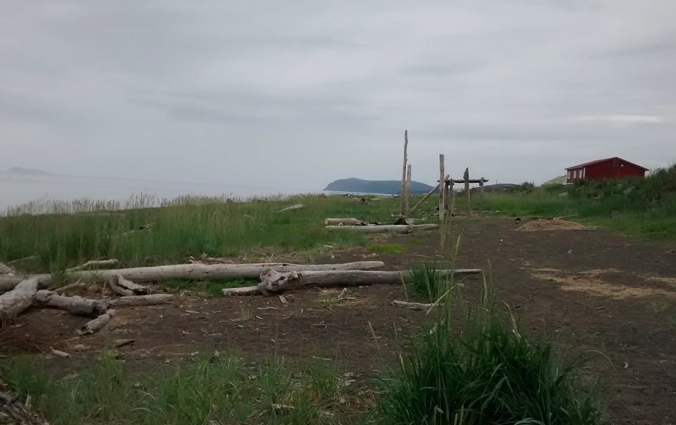
Remote Unmanned Aircraft System (UAS) Inspection and
ADAC Program Year 7 Annual Meeting 2-3 June 2021
Response Team Development in the Bering Strait Region
Principal Investigators
Dr. Jessica Garron, Science Team Lead, Alaska Center for Unmanned Aircraft Systems Integration, University of Alaska Fairbanks
John Henry Jr, Deputy Director, Native Village of Unalakleet
Margy Hall, Associate Director, Model Forest Policy Program
CDR Jereme Altendorf, USCG Sector Anchorage Project Champions
CDR Chad Thompson, USCG HQ
LCDR John Walters, USCG HQ
ADAC: Research for the Arctic Operator… For Today and For the Future
Unalakleet Shoreline (AK). Credit: MW Hall

Slide 4
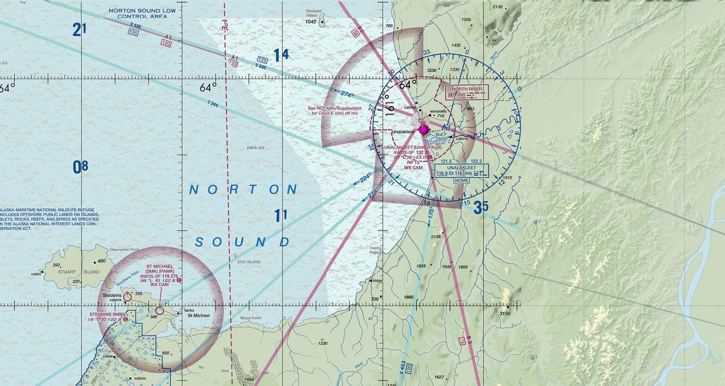
Remote Unmanned Aircraft System (UAS) Inspection and Response Team Development in the Bering Strait Region
ADAC Program Year 7 Annual Meeting 2-3 June 2021
UAS Pilots–in-training
Katie Daniels
Les Kayokluk
Thomas Alakayak
George Woods
Jerald Arca Sr.
Joh Henry Jr.
ADAC: Research for the Arctic Operator… For Today and For the Future

Slide 5
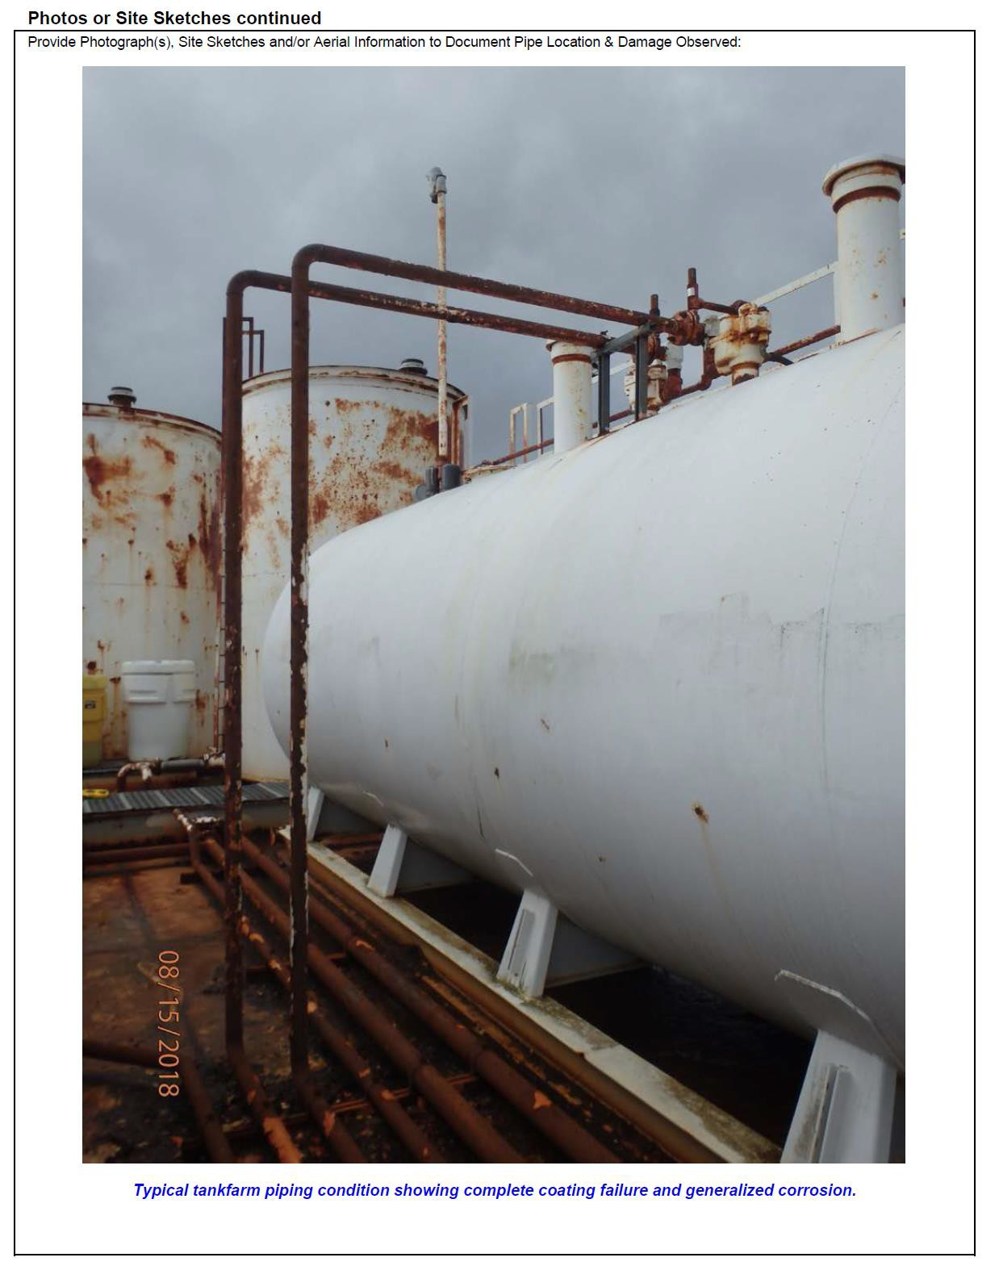
Baseline Conditions and Project Relevance
ADAC Program Year 7 Annual Meeting 2-3 June 2021
USCG Mission Needs
Diminished sea ice coverage in Northern oceans allows for more vessel traffic in the Bering Sea
USCG responders have identified the need for more effective strategies to prevent and address marine disaster response in Western Alaska, and specifically the Bering Strait region.
A critical need exists to improve inspections and inspection frequency of rural bulk fuel facilities across remote regions in the Arctic and Western Alaska
USCG D17 Sector Anchorage identified staffing challenges, extraordinary logistics and associated costs of travel to remote/off road system rural Alaska
  363 regulated facilities not on road system requiring inspection; 6 billeted facility inspectors
ADAC: Research for the Arctic Operator… For Today and For the Future
Sample bulk fuel storage tank in remote Alaska. Image courtesy of the Denali Commission

Slide 6
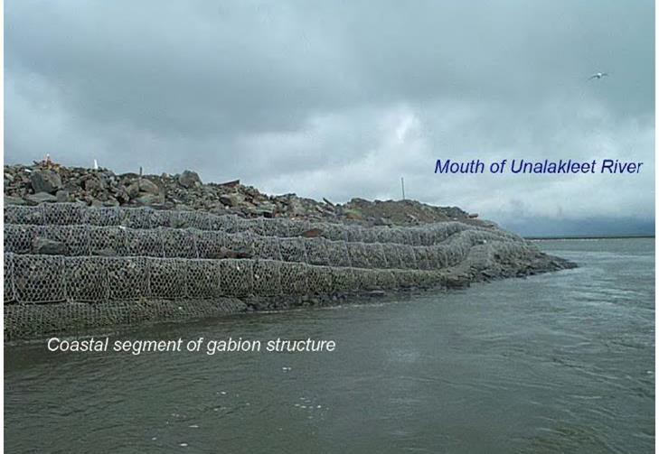
Baseline Conditions and Project Relevance
ADAC Program Year 7 Annual Meeting 2-3 June 2021
Unalakleet Community Needs
Impacts of diminished sea ice coverage in Northern oceans,
A precursor study competed in 2020 by the Project Leads focused on Unalakleet, Alaska, Improving Local Decision Making in Alaskan Communities with Drones and Online Climate Data Tools - A UAS Implementation Feasibility Study Project, identified UAS as a viable tool in support of local decision-making in remote Alaska
More vessel traffic in the Bering Sea
Reduced offshore ice protection
Increased frequency of fall storms
Increased current flow and direction
Changing river conditions are causing,
Early breakup
More turbidity
Increased erosion
Need localized solution for broad situational awareness during emergencies
Search and rescue activities
Oil spill detection and monitoring
Flood delineation
ADAC: Research for the Arctic Operator… For Today and For the Future
Coastal segment of gabion structure in Unalakleet. Photo courtesy of John P. Henry, Jr.

Slide 7
Project Rationale and Description
UAS potentially provide a localized, inexpensive, remote sensing solution, ideal for hazardous and hard to access tasks in remote Alaska.
ADAC Program Year 7 Annual Meeting 2-3 June 2021
This project is designed to develop UAS pilot teams in the Bering Strait region in support of decision-making about infrastructure status and emergency response activities. This work includes the remote training and certification of 7 members of the Unalakleet community to be UAS pilots, the coproduction of bulk fuel infrastructure assessment and emergency response UAS protocols, inclusive of remote data delivery investigations, the feasibility of expanding this training program regionally, and the broad dissemination of knowledge gained to other remote Arctic communities interested in applying UAS technology to local decision-making.

Slide 8
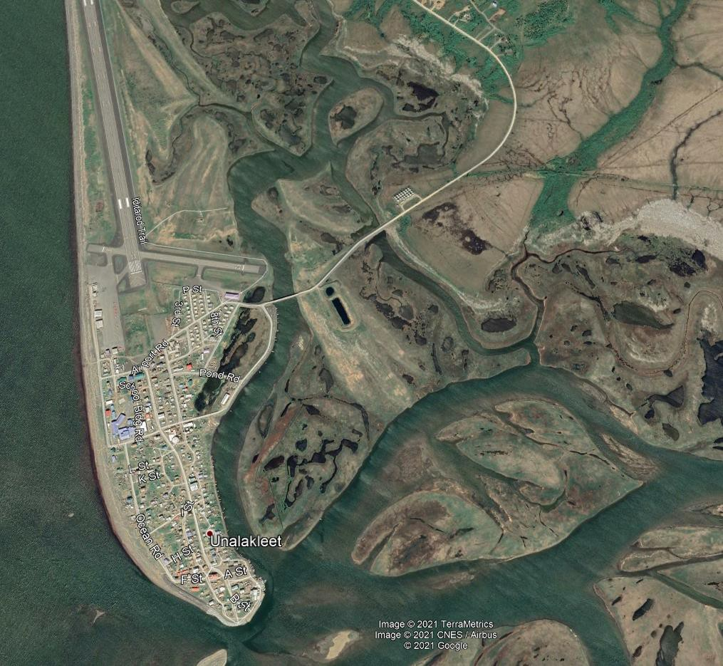
Remote Unmanned Aircraft System (UAS) Inspection and Response Team Development in the Bering Strait Region: Methodology
ADAC Program Year 7 Annual Meeting 2-3 June 2021
Scenario-based research design
Community needs
USCG mission
UAS applications

Slide 9
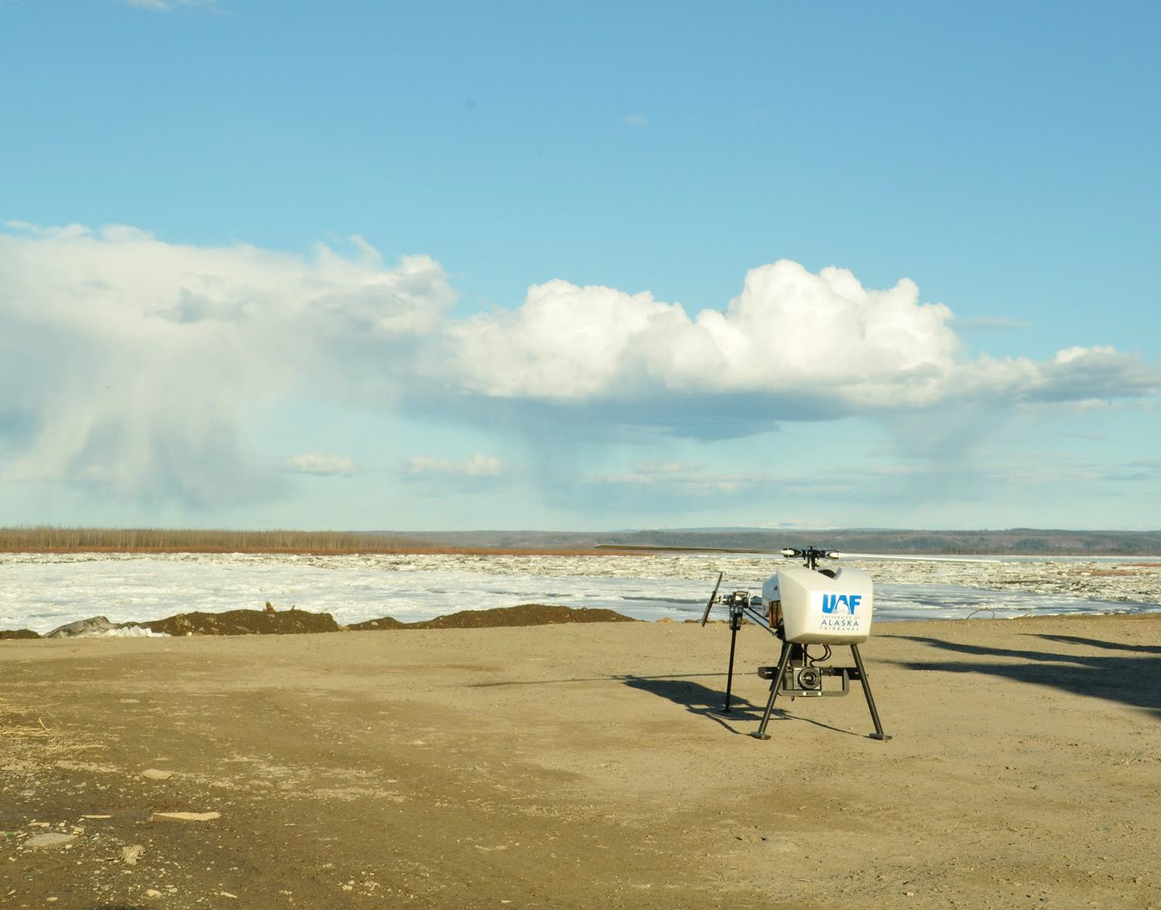
Primary Project Scenarios
ADAC Program Year 7 Annual Meeting 2-3 June 2021
Methodology
Emergency Response
Infrastructure Inspection
Search and Rescue Support with UAS
Flood Monitoring with UAS
Oil Spill Detection and Monitoring with UAS
Bulk Fuel Storage Tank Infrastructure Inspection with UAS
ADAC: Research for the Arctic Operator… For Today and For the Future

Slide 10
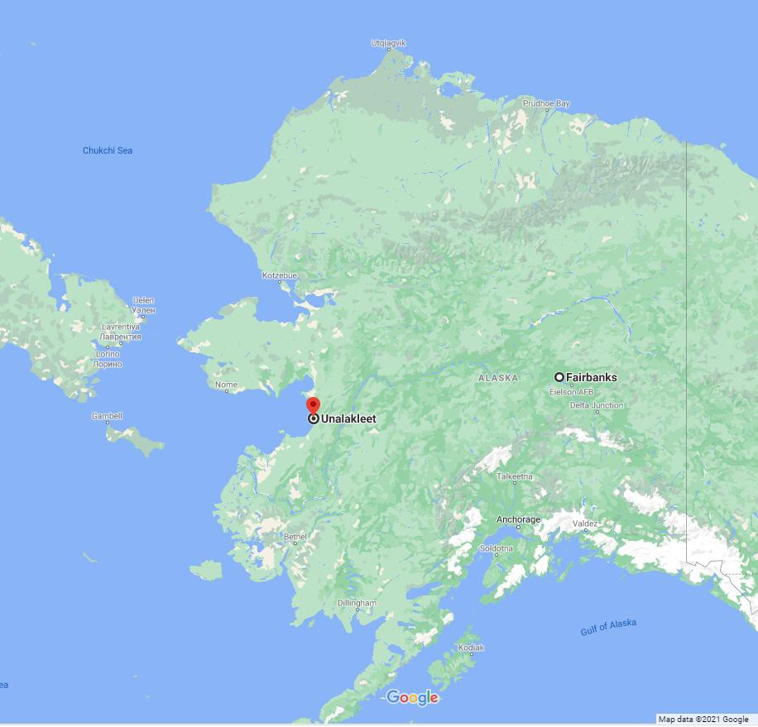
Methodology
ADAC Program Year 7 Annual Meeting 2-3 June 2021
Sequenced methodology is oriented to,
Provide UAS pilot training of rural residents,
Establish co-production of infrastructure assessment operational UAS protocols,
Establish co-production of emergency assessment UAS protocols,
Conduct information dissemination,
Provide regional expansion feasibility analysis.

Slide 11
Remote Unmanned Aircraft System (UAS) Inspection and Response Team Development in the Bering Strait Region: Schedule and Metrics
ADAC Program Year 7 Annual Meeting 2-3 June 2021
Task 1: UAS Pilot Training and Certification
Task 2: Coproduction of Infrastructure Inspection Operational Protocols
Task 3: Coproduction of Emergency
Response Assessment Protocols
Task 4: Regional Expansion Feasibility Assessment
Task 5: Information Dissemination
June 2021
April 2022

Slide 12
Primary Tasks and Objectives
ADAC Program Year 7 Annual Meeting 2-3 June 2021
November 1, 2020 - April 30, 2022
Task 0 – Project Coordination Program establishment (complete),
Conduct team coordination meetings – internal/external (on-going), Reporting (on-going).
Task 1 – UAS Pilot Training and Certification Recruit UAS pilot teams (complete),
Deliver remote UAS pilot training (on-going),
Acquire operational UAVs, sensors and software (in-process) Support FAA certification of UAS pilots (June),
Deliver on-site UAS flight training (June/July).
Task 2 - Coproduction of Infrastructure Inspection Operational Protocols
Determine current tank and fuel delivery infrastructure inspection requirements (on-going),
Coproduce a UAS-based tank and fuel delivery infrastructure inspection protocol (in-process),
Perform infrastructure inspection flights and product delivery tests.
Task 3 - Coproduction of Emergency Response Assessment Protocols Determine key community assets for monitoring pre/post emergency response (on-going),
Coproduce emergency response UAS protocol based upon surveys of key community assets,
Perform emergency response baseline flights and product delivery tests.
Task 4 – Regional Expansion Feasibility Assessment Summarize key (local and regional) documents for critical infrastructure and emergency response information,
Develop regional contact list and conduct regional UAS survey, Aggregate survey results.
Task 5 - Knowledge Product Development Information Dissemination Create USCG-focused Knowledge Project,
Engage non-technical stakeholders (locally, regionally, nationally) (on- going),
Develop and submit publication about sensor capacity testing and general inspection methodology to technical journal.

Slide 13
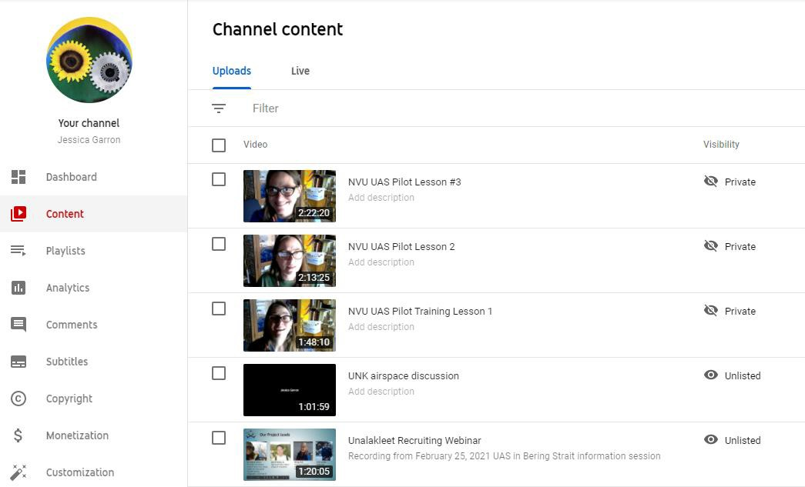
Remote Unmanned Aircraft System (UAS) Inspection and Response Team Development in the Bering Strait Region: Task 1 – UAS Pilot Training and Certification
ADAC Program Year 7 Annual Meeting 2-3 June 2021
Recruit UAS pilot teams (complete),
Deliver remote UAS pilot training (in-process)
  Mondays from 1300-1500 AKDT via Zoom,
Acquire operational UAVs, sensors and software (in-process)
Support FAA certification of UAS pilots (June),
Deliver on-site UAS flight training (June/July).

Slide 14
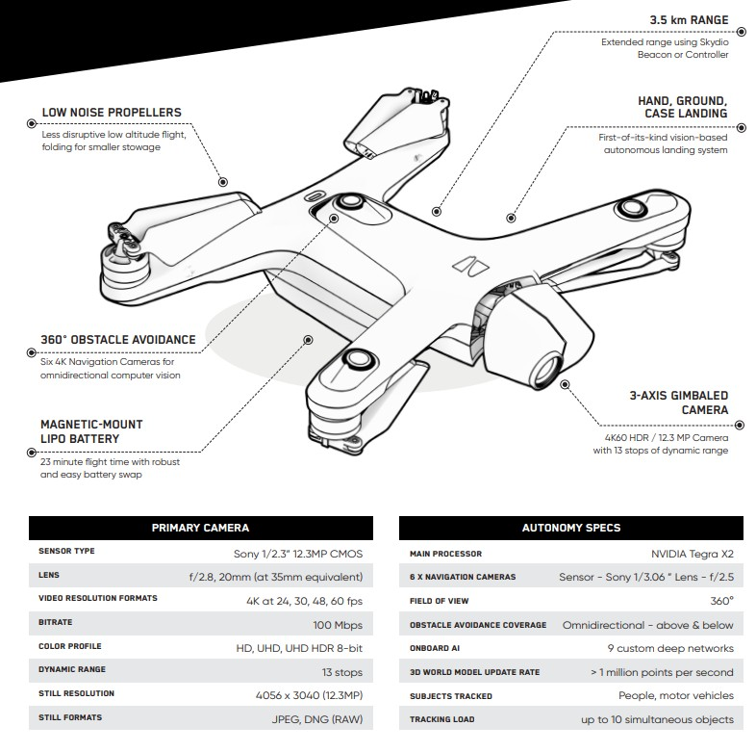
Remote Unmanned Aircraft System (UAS) Inspection and Response Team Development in the Bering Strait Region: Task 1 – UAS Pilot Training and Certification
ADAC Program Year 7 Annual Meeting 2-3 June 2021
Skydio
Designed, assembled and supported in the USA
3D scan for infrastructure inspections
360° obstacle avoidance via AI powered autonomy
S2E - Training Aircraft (2)
  RGB sensor
  In transit to Alaska
X2E - Operational Aircraft (5)
  RGB and Longwave infrared (thermal) sensor
  Anticipated June delivery date

Slide 15
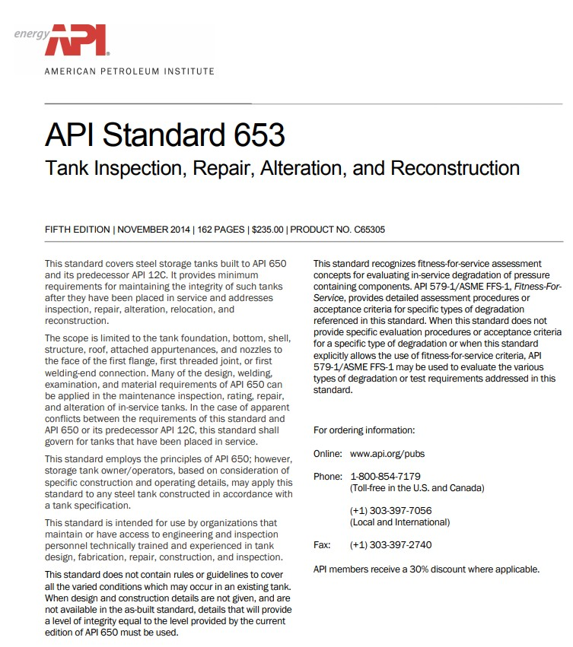
Remote Unmanned Aircraft System (UAS) Inspection and Response Team Development in the Bering Strait Region: Task 2 - Coproduction of Infrastructure Inspection Operational Protocols
ADAC Program Year 7 Annual Meeting 2-3 June 2021
Determine current tank and fuel delivery infrastructure inspection requirements (in-process),
Coproduce a UAS-based tank and fuel delivery infrastructure inspection protocol (in-process),
Perform infrastructure inspection flights and product delivery tests (July).

Slide 16

Remote Unmanned Aircraft System (UAS) Inspection and Response Team Development in the Bering Strait Region: Task 3 - Coproduction of Emergency Response Assessment Protocols
ADAC Program Year 7 Annual Meeting 2-3 June 2021
Determine key community assets for monitoring pre/post emergency response (in-process),
Coproduce emergency response UAS protocol based upon surveys of key community assets (July/August),
Perform emergency response baseline flights and product delivery tests (July/August).
Image courtesy of skycoreaviation.com

Slide 17
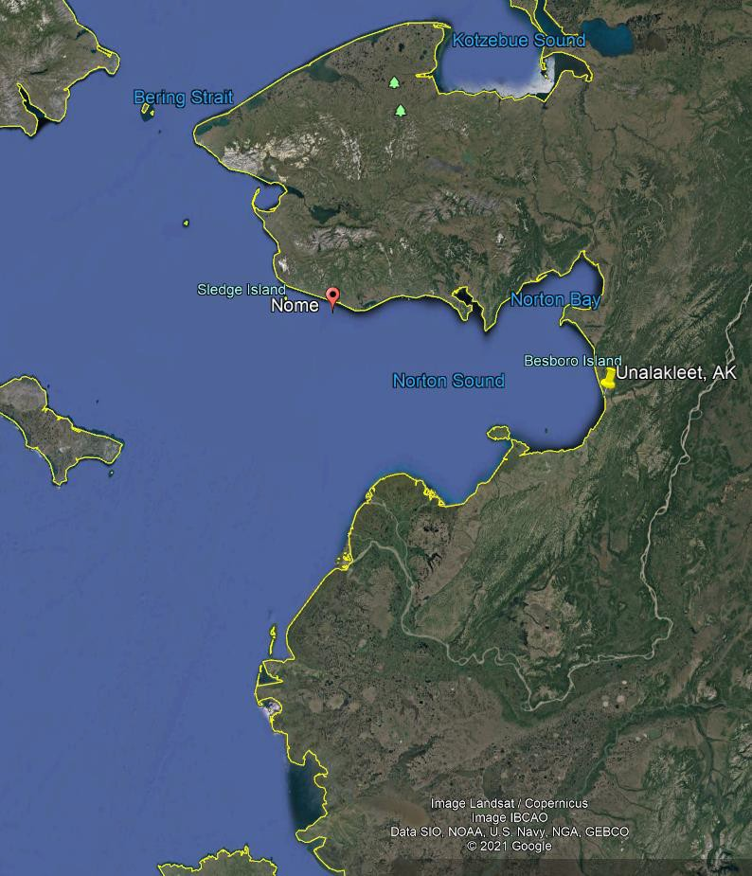
Remote Unmanned Aircraft System (UAS) Inspection and Response Team Development in the Bering Strait Region: Task 4 – Regional Expansion Feasibility Assessment
ADAC Program Year 7 Annual Meeting 2-3 June 2021
Summarize key (local and regional) documents for critical infrastructure and emergency response information (June/July),
Develop regional contact list and conduct regional UAS survey (in-process),
Aggregate survey results (August).

Slide 18
Remote Unmanned Aircraft System (UAS) Inspection and Response Team Development in the Bering Strait Region: Task 5 - Knowledge Product Development & Information Dissemination
ADAC Program Year 7 Annual Meeting 2-3 June 2021
Create USCG-focused Knowledge Project (June – December),
Engage non-technical stakeholders (locally, regionally, nationally) (on-going),
Develop and submit publication about sensor capacity testing and general inspection methodology to technical journal (March 2022).

Slide 19
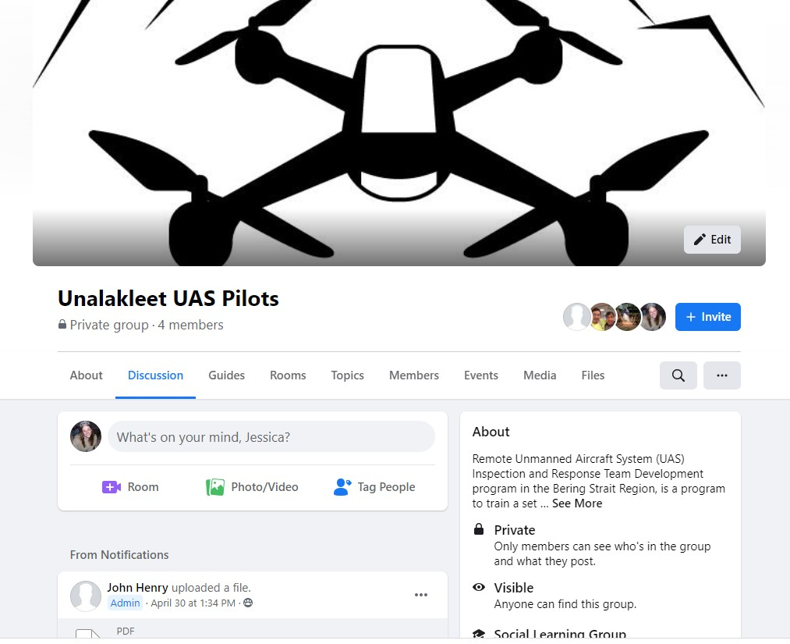
Remote Unmanned Aircraft System (UAS) Inspection and Response Team Development in the Bering Strait Region: Task 5 - Knowledge Product Development & Information Dissemination
ADAC Program Year 7 Annual Meeting 2-3 June 2021
Engage non-technical stakeholders (locally, regionally, nationally) (on-going)
*FB page for pilot blogging and Q&A
*Google Drive for document archiving
*Email, text, phone communications

Slide 20
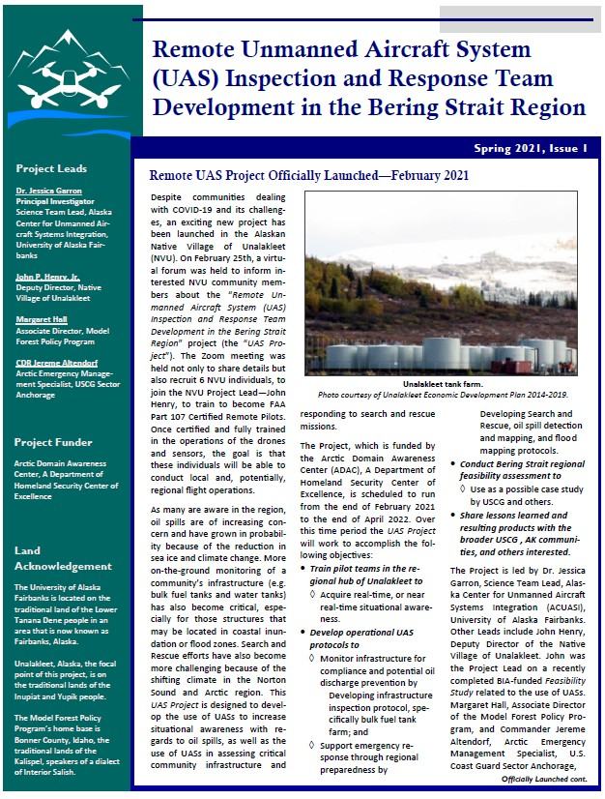
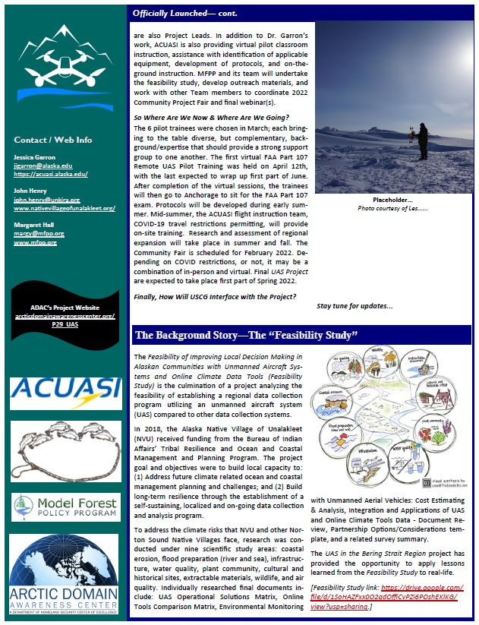
Remote Unmanned Aircraft System (UAS) Inspection and Response Team Development in the Bering Strait Region: Task 5 - Knowledge Product Development & Information Dissemination
ADAC Program Year 7 Annual Meeting 2-3 June 2021
Engage non-technical stakeholders (locally, regionally, nationally) (on-going)
*Quarterly newsletter
*Presentations
(WAISC, Cal-OSPR, ASSW)

Slide 21
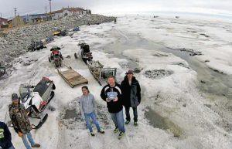
Remote Unmanned Aircraft System (UAS) Inspection and Response Team Development in the Bering Strait Region: Planned Research Outcomes
ADAC Program Year 7 Annual Meeting 2-3 June 2021
A knowledge product for the USCG as a possible use case for other areas/applications
A developed set of operational UAS protocols for
Monitoring infrastructure for compliance and prevention of potential oil discharge identification
Emergency response support through regional preparedness
Development of pilot teams in the regional hub of Unalakleet
  Creates the ability to acquire real-time, or near real-time situational awareness where there currently is none
Bering Strait regional feasibility assessment for UAS program implementation
Photo courtesy Charlie Parr/Alaska Upward Bound.

Slide 22
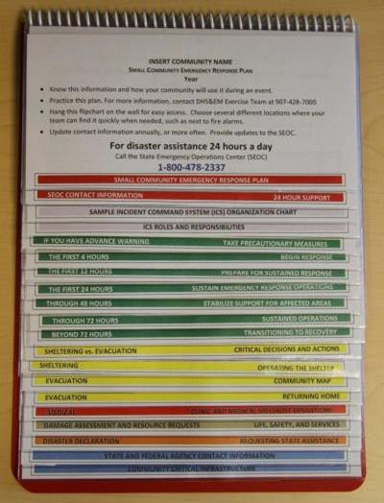

Impacts and Applications
Remote Unmanned Aircraft Systems (UAS) Inspection and Response Team Development in the Bering Strait Region
UAS enhanced support of...
FEMA Hazard Mitigation Plans
State of Alaska DHS&EM Small Community Emergency Response Plans
(SCERP)
Local infrastructure monitoring capacity and fund acquisition
USCG regional inspection support
USCG regional emergency response
Arctic security - surveillance
State of Alaska DOT asset integrity - Runways, roads, bridges
Bering Strait regional energy planning processes
Bering Strait economic development plans
ADAC: Research for the Arctic Operator… For Today and For the Future

Slide 23
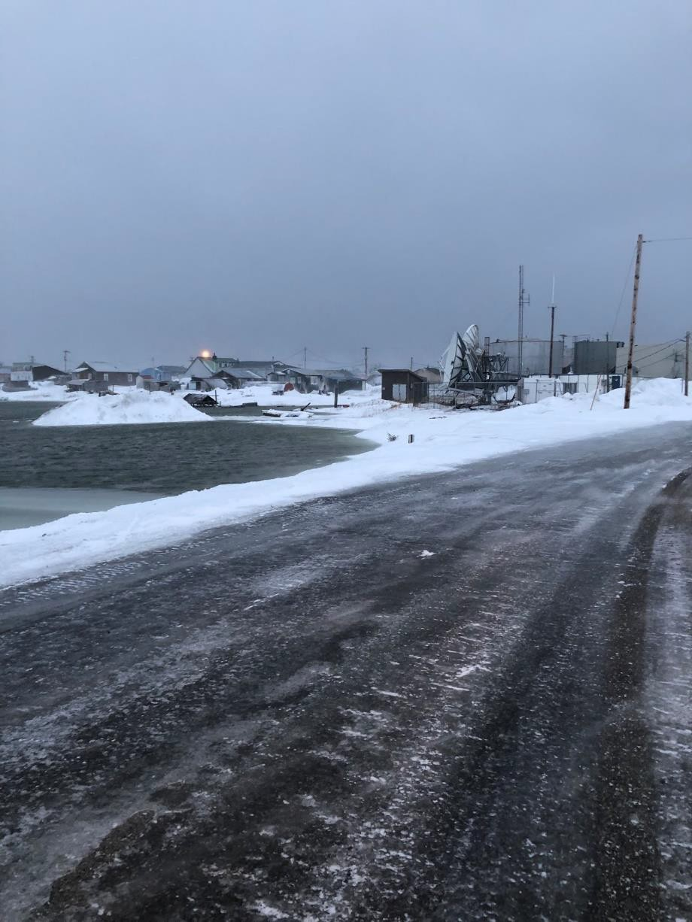

Beyond Unalakleet...
Regional Expansion Feasibility Analysis in Support of Transition Planning
Determine long-term implementation strategies in the region.
Identify, assess, and prioritize critical infrastructure, vulnerable community assets, and emergency response capacity and protocols.
Outreach to local, regional and federal entities (e.g. IGAP coordinators, public works staff, emergency responders and communications technicians) for critical input.
Clarify entities’ relationships to an expanded program.
Report findings.

Slide 24

Remote Unmanned Aircraft System (UAS) Inspection and Response Team Development in the Bering Strait Region: Questions and Feedback
ADAC Program Year 7 Annual Meeting 2-3 June 2021
Dr. Jessica Garron jigarron@alaska.edu
Thank You

